Slide 1

Technical Exam
- Data Analyst
Author: Ming-Tsung (Julius) Lee

Slide 2
Context
Formula for Life Time Value for a particular cohort
Factors that impact the length
Monthly Retention Curve
Cumulative Retention Curve
Cumulative Retention Curve for 2019 cohorts’ prediction
Other findings
1

Slide 3
Formula for Life Time Value for a particular cohort
Metrics:
Monthly Retention Rates across the cohort lifetime (MRR)
Commission Per Member Per Month (CMPM)
Interest Rate (IR)
Member count for the cohort (Mem_Cnt)
2

Slide 4
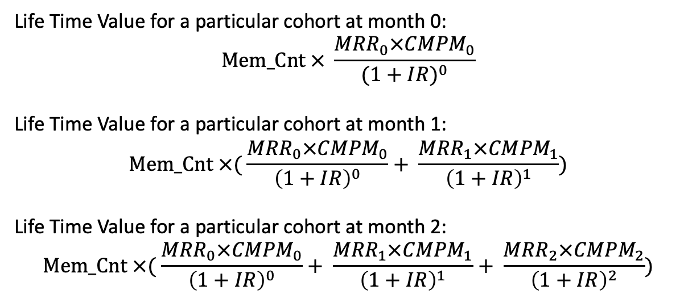
Formula for Life Time Value for a particular cohort
Life Time Value for a particular cohort at month 0:
$$Mem_Cnt × \frac{{MRR}_{0}×{CMPM}_{0}}{{(1+IR)}^{0}}$$
Life Time Value for a particular cohort at month 1:
$$Mem_Cnt ×( \frac{{MRR}_{0}×{CMPM}_{0}}{{\left(1+IR\right)}^{0}}+ \frac{{MRR}_{1}×{CMPM}_{1}}{{\left(1+IR\right)}^{1}})$$
Life Time Value for a particular cohort at month 2:
$$Mem_Cnt ×( \frac{{MRR}_{0}×{CMPM}_{0}}{{\left(1+IR\right)}^{0}}+ \frac{{MRR}_{1}×{CMPM}_{1}}{{\left(1+IR\right)}^{1}}+ \frac{{MRR}_{2}×{CMPM}_{2}}{{\left(1+IR\right)}^{2}})$$
3

Slide 5
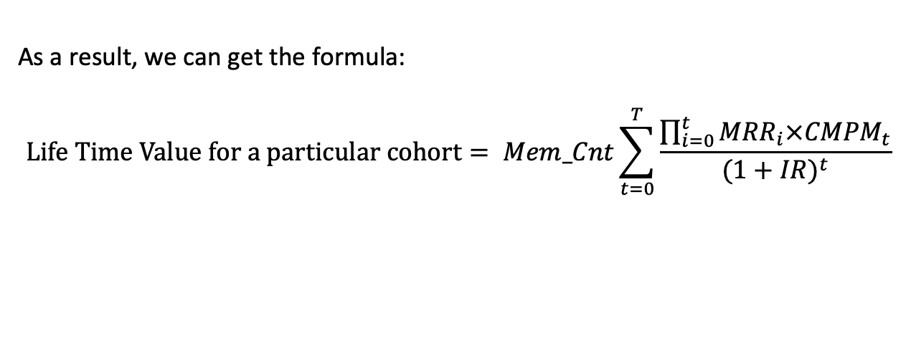
Formula for Life Time Value for a particular cohort
As a result, we can get the formula:
$$Life Time Value for a particular cohort= Mem_Cnt\sum_{t=0}^{T}{\frac{\prod_{i=0}^{t}{{MRR}_{i}×{CMPM}_{t}}}{{(1+IR)}^{t}}}$$
4

Slide 6
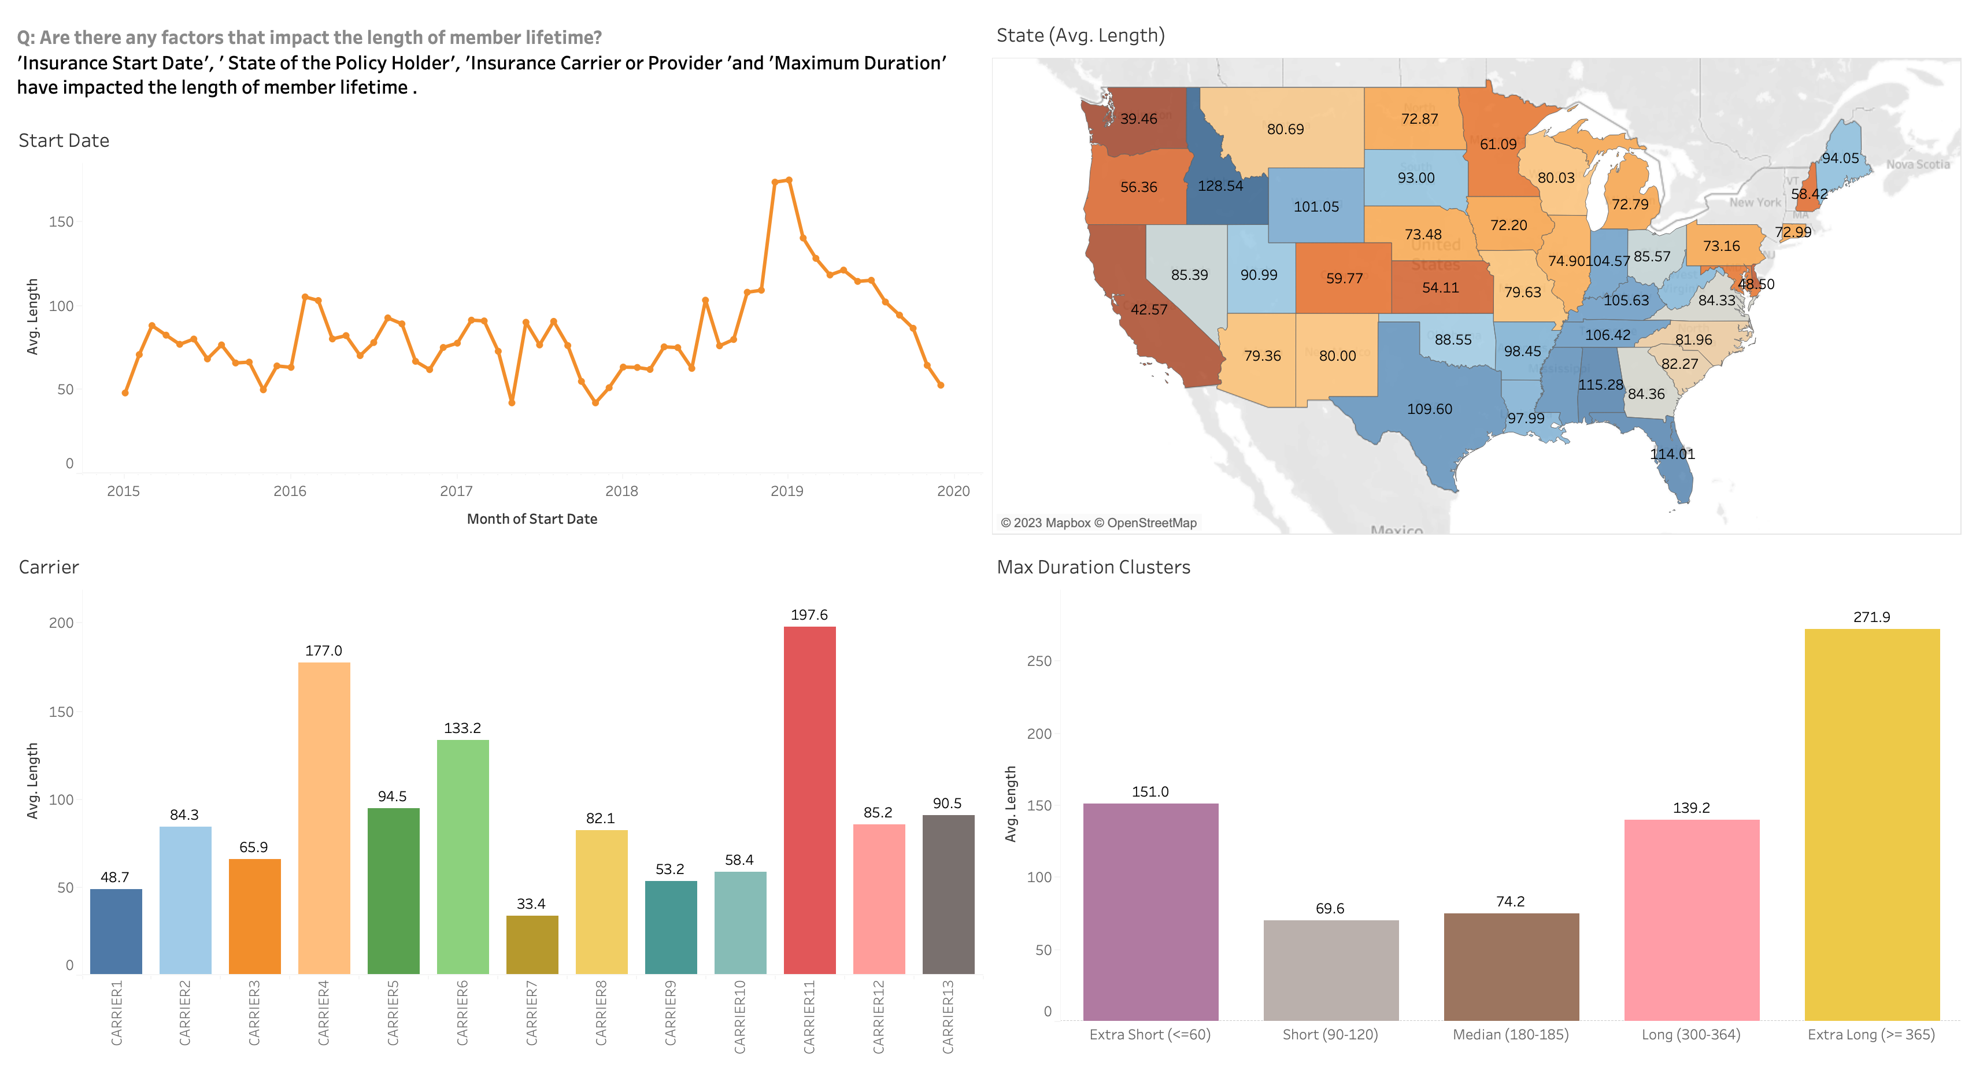
Factors that impact the length
5

Slide 7
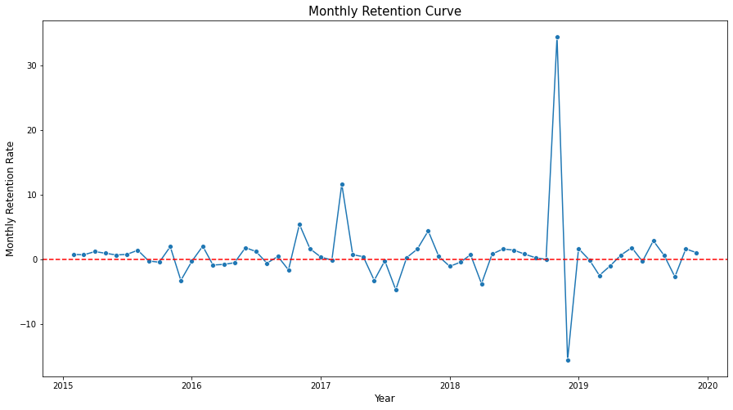
Monthly Retention Curve
The majority of the monthly retention rates hover around 0. However, there are notable spikes in March 2017 and November 2018, along with a significant decline in December 2018.
6

Slide 8
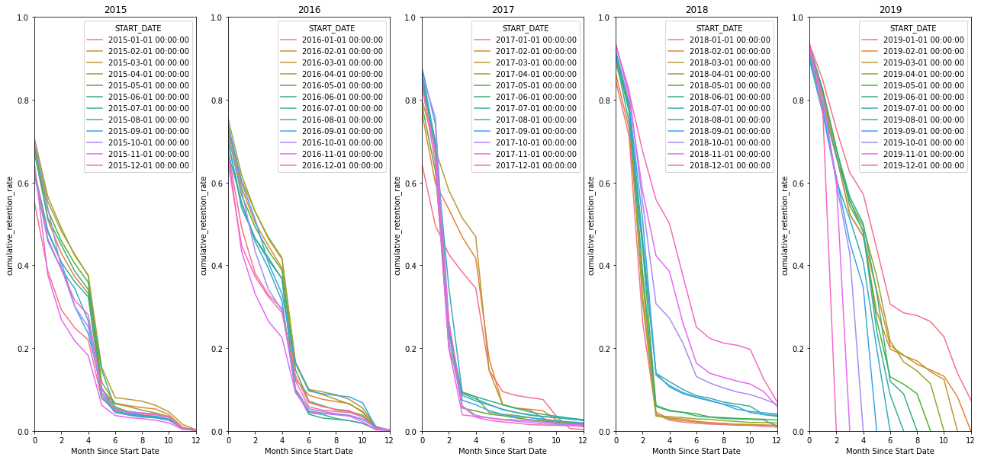
Cumulative Retention Curve
7

Slide 9
Cumulative Retention Curve
Based on the line charts shown, it is evident that there are primarily two types of Cumulative Retention Curves. The first one demonstrates a gradual decline from month 2 to month 4. Conversely, the second type experiences a significant drop during the same time period.
If the cohort start date falls before April 2017 or after September 2018, the Cumulative Retention Curve will be similar to the first type. However, if the cohort start date falls between April 2017 and September 2018, the Cumulative Retention Curve will look like the second type. This indicates that an event or circumstance may have occurred during the period of April 2017 to September 2018, resulting in a change in the Cumulative Retention Curve.
8

Slide 10
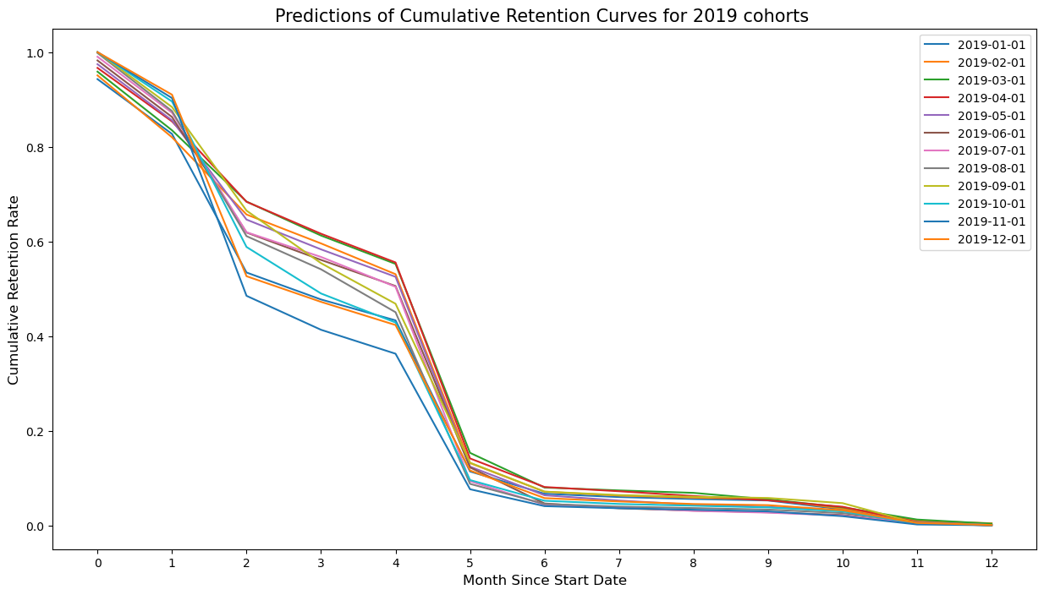
Cumulative Retention Curve for 2019 cohorts’ prediction
My prediction of the Cumulative Retention Curve for 2019 cohorts:
9

Slide 11
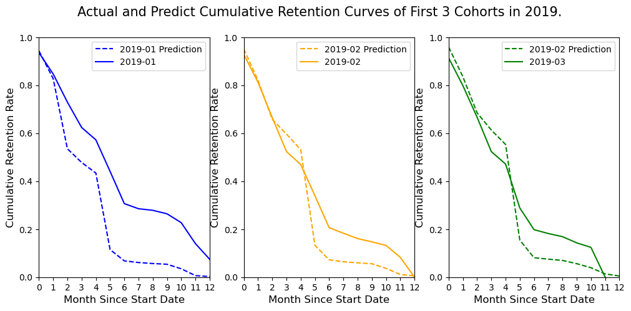
Cumulative Retention Curve for 2019 cohorts’ prediction
Compare the first 3 months of actual and predict Cumulative Retention Curve:
The predicted curves experience a significant drop in the fifth month. However, in reality, the actual curves only show a relatively slight decrease in the fifth and sixth months.
10

Slide 12
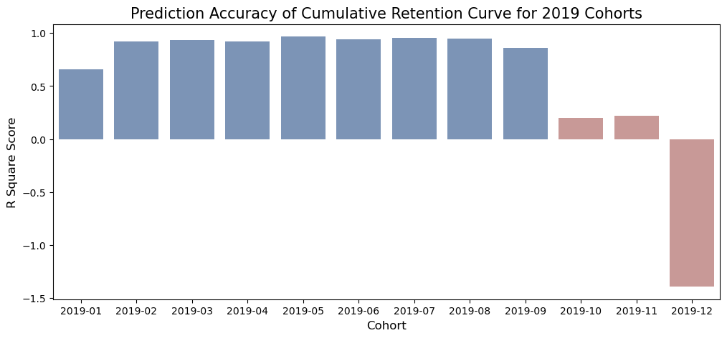
Cumulative Retention Curve for 2019 cohorts’ prediction
The histogram reveals that the predictions are accurate for the first nine cohorts in 2019 but perform poorly for the last three cohorts. It is because of the smaller amount of data available for the last three cohorts, resulting in lower prediction accuracy.
11

Slide 13
Other findings
Prior to the insurance start date, more than 5000 customers had already churned. (Churn Date < Start Date)
There may be some relationship between Insurance carrier or provider and State of the policy holder.
12

